Slide 1
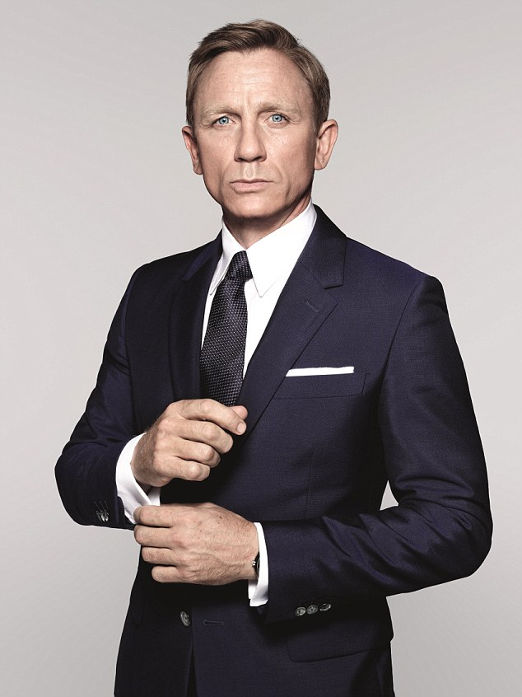
Bond Yield and Calculations

Slide 2
Bond Yield
What would give a better return on your investment?
An 11% bond bought at 980 or
A 12% bond bought at 1020?
The answer will depend upon the amount of interest you get with the bond, the market price, and how long before the bond matures.
Assumptions: Each bond is a $100 or $1000 bond

Slide 3
What is Yield?
The total return you get when you invest in a bond
Made up of:
- Fixed coupon payments
- Capital gain or loss incurred when you sell the bond or it matures

Slide 4
Formula
Current Bond Yield = Annual Income
Current Market Price
Annual Income = Annual Interest + Capital Gain Per Year
Annual Income = Annual Interest - Capital Loss Per Year

Slide 5
Quick Check
If the market price of the bond is lower than the face value, the yield should be greater than the coupon rate
Yield > Coupon Rate
If the market price of the bond is higher than the face value, the yield should be lower than the coupon rate
Yield < Coupon Rate

Slide 6
Example 1:
Find the approximate yield on a 14% $100 bond due in 10 years if bought at 98?
Answer:
Ann. Inc. = Ann. Interest + Cap Gain Per Yr
Annual Income =($100 x 0.14) + (100-98)/10
=$14 + 2/10
=$14 + 0.20 = $14.20
Yield = $14.20/98 = 0.1449 = 14.49%

Slide 7
Example 2:
Find the approximate yield on a 11% $100 bond due in 10 years if bought at 102?

Slide 8
Example 2:
Answer:
Ann. Inc. = Ann. Interest – Cap Loss Per Yr
Annual Income = ($100 x 0.11) - (102-100)/10
= $11 - 0.20 = $10.80
Yield = $10.80/102 = 0.10588 = 10.59%

Slide 9
Example 3:
Find the approximate yield on a 9% $100 bond due in 20 years if bought at 76?

Slide 10
Example 3:
Answer:
Ann. Inc. = ($100 x 0.09) + (100-76)/20
= $9 + 24/20 = $9 + $1.20 = $10.20
Yield = $10.20/76 = 0.1342 = 13.42%

Slide 11
Video
http://www.investopedia.com/terms/b/bond-yield.asp

Slide 12
Bond Calculations:
Annual Interest = Face Value X Coupon Rate
Market Price = Face Value X Market Value (as a %)
Capital Gain/Loss Per Yr = (Face Value - Market Price)/ Number of Yrs to Maturity
Return Per Year = Annual Interest + Capital Gains or Annual Interest - Capital Loss
Average Price Of Bond = (Face Value + Market Price) / 2
Yield = Return Per Year / Average Price of Bond X 100 -- Answer expressed as a %

Slide 13
Example:
Bond has $1000 face value but you paid $950 for it with an interest rate of 10%, with 2 years to maturity
Annual Interest
1000*10% = 100/year
Capital Gain per year
1000-950=50/2=$25/year
Your return per year
$100+$25=$125
Average price of the bond
(950+1000)/2 = $975
Yield
(125/975)*100% = 12.82%

Slide 14
Handout
Answer questions on hand out
I will collect the answers at the end of class

Slide 15
Next Class- Buying and Selling Bonds
http://www.investopedia.com/video/play/par-value/

