Slide 1
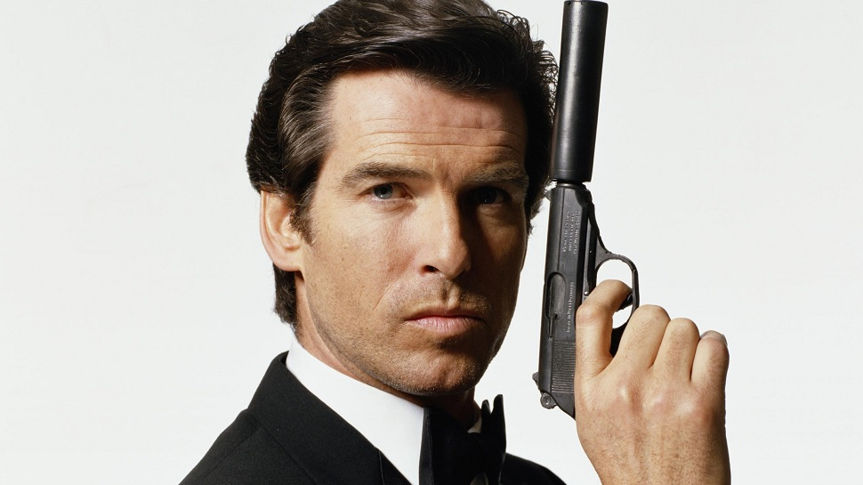
Buying and Selling Bonds

Slide 2
Video
https://www.youtube.com/watch?v=C1FPhvk17B8

Slide 3
Bond Trading
When buying or selling bonds on the secondary market, there are two very important components to consider:
Market Price
Interest Rate and when interest was last paid
Bond Interest is usually paid once or twice a year (annually or semi-annually)

Slide 4
Selling Bonds
When a bond is sold, the buyer always receives the next full interest payment whether it is a semi-annual or annual pmt.
For example:
If I sold a bond on March 1st, and this bond paid semi-annual interest on Oct. 31st and Apr. 30th, the buyer would receive the interest payment cheque covering Nov. 1st to Apr. 30th. Is he entitled to all this interest?

Slide 5
Selling Bonds
In the preceding example, logic would state that I should be entitled to interest from Nov 1st to Feb. 28th and the buyer should be entitled to interest from March 1st to Apr. 30th.
How do I handle this?
When I sell him the bond on March 1st , I charge him the interest owed to me at the time. This is called accrued interest.

Slide 6
Selling Bonds
When selling a bond on any other day except the interest payments dates, the buyer will pay market price plus accrued interest to the seller.
For the seller, it represents additional proceeds
For the buyer, it represents an additional cost

Slide 7
Selling Bonds- The Math
Step One:
Determine the market price (market value) of the bond
Market Price = Face Value of Bond x Market Value Percentage
Example One:
What is the mkt value of a $500 bond at 97 ½%
Answer:
$500 x 97.5% = $500 x 0.975 = $487.50
Example Two;
What is the mkt value of a $2000 bond at 103.5
Answer:
$2000 x 103.5% = $2000 x 1.035 = $2070

Slide 8
Selling Bonds- The Math
Step Two
Determine the accrued interest owed to the seller.
Example:
A $ 1000 11% face value bond was sold for 98.5% on August 10th. Interest was last paid on June 1st
Answer:
Count the days since last payment-start with the pmt date and do not include the selling date
30 days in June, 31 days in July and 9 days in Aug
70 days altogether

Slide 9
Selling Bonds- The Math
The formula for calculating interest is:
Interest = Principle x Annual Rate x Time (years)
In the preceding example it would be:
$1000 x 0.11 x 70/365 (must express time in years-we do this by dividing the number of days by 365)
This gives us $21.10 accrued interest
Proceeds = mkt value + accrued interest
Mkt Val = $1000 x 98.5% = $985
Proceeds = $985 + $21.10 = $1006.10

Slide 10
Buying Bonds
When buying bonds, the exact same math is done from the buyers point of view.
The buyer will pay market value for the bond plus interest payable calculated the same way.
Interest Payable = P x R x T
Bond Cost = Mkt Val + Interest Payable

Slide 11
Example 1:
Julie bought a $500 13.5 % bond bearing coupons payable semi-annually on June 30th and Dec. 31st at 92 ½. What would the cost be if she bought the bond on Sept 15th?
Market Value = $500 x 92.5% = $462.50
Interest Days = 1 in Jun, 31 in Jul, 31 in Aug, 14 in Sept
Int = $500 x 0.135 x 77/365 = $14.24
Cost of bond = $462.50 + $14.24 = $476.74

Slide 12
Example 2:
Find the proceeds of selling a 7% $750 corporate bond at 72 on June 1st if interest is payable annually on April 1st.

Slide 13
Example 2 Answer:
Mkt Val = $750 x 72% = $540
Interest days = 30 in Apr, 31 in May
I = $750 x 0.07 x 61/365 = $8.77
Proceeds = $540 + $8.77 = $548.77

Slide 14
Mimeo Example 1:
A $500 9% face value bond was sold for 72% on June 1. Interest was last paid on April 1. What is the total cost of buying the bond?

Slide 15
Mimeo Example 2:
A $5000 12.375% face value bond was sold for 89.50% on Dec 29. Interest was last paid on Dec 15. What is the total cost of buying the bond?

Slide 16
Activity:
In groups of 4, do questions given on the whiteboards
One person writes, others tell them what to write
We will go over answers as a class

